Slide 1



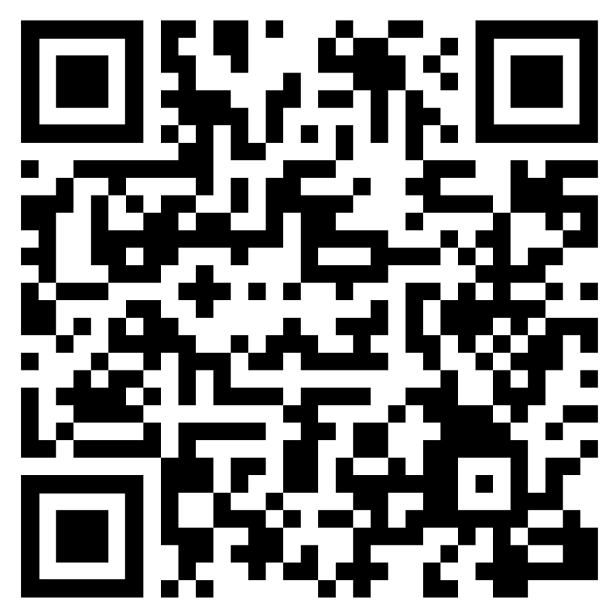
Version 2.0 February 2024
Notes:
Image source: Stock image from PPT

Slide 2
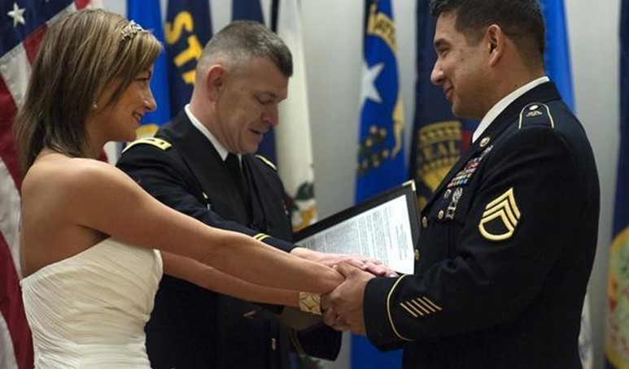






Agenda
Communication
Administrative Tasks
Financial Planning
Insurance
Legal Documents and Taxes
Resources
Notes:
Image source: https://www.dvidshub.net/image/2387083/just-married-retired

Slide 3






Communication
Discuss with your new spouse:
Financial Situation
Financial Goals
Spending
Saving and Investing
Planning
Notes:
Image source: https://www.pexels.com/photo/happy-young-multiracial-couple-taking-on-sofa-at-home-4049517/

Slide 4



Activity
Financial Goals
Saving and Investing
Spending
Fill out
My Rating as a
Money Manager handout
Notes:
Image sources:
https://www.pexels.com/photo/newlywed-facing-each-other-under-white-textile-1532657/
https://unsplash.com/photos/deU5g94iAy0
Alternate image option:
https://unsplash.com/photos/1q0r2uvFYIs

Slide 5

Administrative Tasks
To-Do
Documents
Power of Attorney
DEERS
Changes to Pay
Child Considerations

Slide 6
Financial Planning

Slide 7

Spending Plan
Step 1:
Understand Your Current Situation
Step 2:
Know Where
Your Money
Should Go
Step 4:
Make
Adjustments
4-Step
Spending Plan
Step 3:
Create a Plan
Notes:
Image source: https://www.pexels.com/photo/couple-in-restaurant-3395282/

Slide 8







Financial Goals
Discuss Financial Goals
Set Financial Goals Together
Figure Out How Much to Save to Achieve Goals
Short-term
Long-term
Use Reminders to Stay on Track
Notes:
Image source: https://www.dvidshub.net/news/392342/3-year-old-home-deployed-couple-withstands-challenges

Slide 9









Financial Planning
Emergency Fund
Housing
Transportation
Banking
Power of Attorney
Payable on Death Designation
Paying Bills
Notes:
Image source: https://www.dvidshub.net/image/786422/army-reserve-civil-affairs-soldier-pushes-himself-through-ranger-school

Slide 10





Credit and Debt
Be a Smart Consumer
Protect Against Identity Theft
Laws to Help Service Members
Use Handouts
Notes:
Image source: Stock image from PPT library

Slide 11






Understanding Credit
FREE Credit Report
FICO Credit Score Ranges
670―739 Good
Review Credit Score
580―669 Fair
740―799 Very Good
300―579 Poor
800―850 Exceptional
Speak to a Financial Counselor
Greater than 670 = Easier to Get Credit
Notes:
Image sources:
https://unsplash.com/photos/g2-pCfjz7Vc
https://www.pexels.com/photo/black-payment-terminal-2988232/
http://clipart-library.com/clipart/credit-score-cliparts_10.htm

Slide 12



5 Factors Driving Your Credit Score
New
Credit
10%
Types of
Credit
10%
FREE Credit Monitoring Available
Length of
Credit History
15%
Payment
History
35%
Amount of Debt Owed
30%
Notes:
Image source: https://www.dvidshub.net/image/560254/1-25th-soldier-makes-marriage-homecoming-priority

Slide 13

Managing Debt
BAH or 25% of pretax pay
15–20% of pretax pay
Total debt less than
36–43% of pretax pay
Pay credit cards in full every month

Slide 14





Retirement
Military Retirement System
Review Retirement Savings Goals
Savings Options
TSP
401(k)
403(b)
IRAs
Notes:
Image source: https://www.dvidshub.net/image/4676029/1st-sfg-soldier-achieves-his-american-dream

Slide 15


Other Benefits
Notes:
Image source: Stock image from PPT

Slide 16

Survivor Benefits
Servicemembers’ Group Life Insurance (SGLI)
Casualty Assistance Office
Dependency and Indemnification Compensation (DIC)
Education Benefits
Heroes Earning Assistance and Relief Tax (HEART) Act
VA Burial at any National Cemetery
Survivor Benefit Plan (SBP)
Survivor Outreach Services (SOS)
Death Gratuity
Social Security Survivors Benefits
Notes:
Image source: https://pixabay.com/photos/black-and-white-people-couple-happy-2590810/

Slide 17




Education Benefits
Education Benefits and Savings Handout
Post-9/11 GI Bill Benefits Transfer
Tuition Assistance
Notes:
Image source: Stock photo from PPT

Slide 18


Spouse Resources
Reimbursement for State Licensure and Certification Costs for the Spouse of a Soldier Arising from a Permanent Change of Station
My Career Advancement Account (MyCAA) Scholarship
Military Spouse Non-Competitive Appointing Authority
Military OneSource and DoD Spouse Education and Career Opportunities (MySECO)
Army Community Service (ACS) Programs
Family Assistance Center (FAC)
United Services Organization (USO)
Military Spouse Employment Partnership
Civilian Personnel Advisory Center (CPAC)
MilSpouse Money Mission®
Notes:
Image sources: Stock photos from PPT

Slide 19

Insurance
Notes:
Image source: https://www.dvidshub.net/image/5562050/love-story-land-morning-calm

Slide 20



Health Insurance
Enroll in DEERS
TRICARE or
TRICARE Reserve Select
Elect Plan
Notes:
Image sources:
Stock images from PPT
https://www.pexels.com/photo/photo-of-couple-standing-on-wooden-planks-2403568/
https://www.dvidshub.net/image/6413012/san-francisco-nurse-reflects-her-participation-federal-covid-19-response-texas

Slide 21



Dental and Vision
Optional to Enroll
Additional Monthly Cost
Federal Employee Dental and Vision
Notes:
Image sources:
https://www.pexels.com/photo/two-persons-wearing-silver-colored-rings-3585798/
https://unsplash.com/photos/wSBQFWF77lI
https://www.pexels.com/photo/woman-having-dental-check-up-3845682/

Slide 22





Property Insurance
Auto
Homeowners
Renters
High-Value Items
Liability
Review and Update Policies

Slide 23

Purpose of Life Insurance
Offers protection for your family
Marriage affects insurance needs
Reduces financial hardship for loved ones
Notes:
Image source: https://unsplash.com/photos/3n_x0JOnOlQ

Slide 24









Life Insurance Overview
Servicemembers’ Group Life Insurance
Family Servicemembers’ Group Life Insurance
Private Life Insurance Options
Automatically insured unless Soldier declined coverage
Enroll spouse
Children automatically insured if Service member is enrolled
Term
Permanent
Notes:
Image source: https://www.pexels.com/photo/photo-of-couple-standing-on-wooden-planks-2403568/

Slide 25





Update Beneficiaries
SGLI
Private Life Insurance
DD 93 and TSP-3
Retirement and Investments
Notes:
Image source: https://www.dvidshub.net/image/5518073/date-night-prague

Slide 26

Life Insurance Needs
Liabilities (debts and obligations)
Income (amount X number of years needed)
Final expenses
Education and other goals
+
+
+
-
Subtract current coverage and assets
Your Total Need
Notes:
Image source: https://www.dvidshub.net/image/4112370/officer-enlisted-couple-promoted-during-rare-same-day-ceremony

Slide 27

Legal Documents and Taxes

Slide 28


Estate Planning
Will
Power of Attorney
Living Will
Trust
Asset Titling
Home of Record/Residency
Guardianship
FREE assistance at installation Legal Services Office
Notes:
Image sources:
https://www.pexels.com/photo/man-and-woman-s-hands-on-top-of-ball-bouquet-1730877/
https://unsplash.com/photos/e0QVpFvn_fE

Slide 29

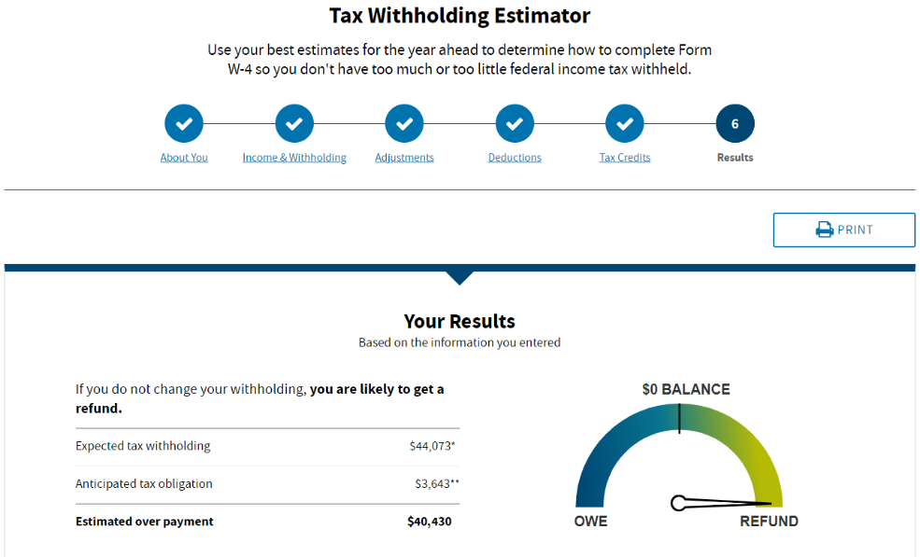






Taxes
Review New Tax Situation
Residency Issues
  Update State
  and Federal Withholding
  Military Spouse Residency Relief Act
  Military OneSource MilTax
  Veterans Benefits and Transitions Act
Notes:
Image sources:
https://www.pexels.com/photo/photo-of-a-couple-looking-at-each-other-2219276/
https://unsplash.com/photos/DUK7XiBpGSY

Slide 30

Summary and Resources
30
Notes:
Image source: https://www.dvidshub.net/image/2518462/strong-bonds

Slide 31


Congratulations!
  Discuss Changing Financial Circumstances with Your Spouse
  Plan First Steps to Prepare Finances for Married Life
Notes:
Image sources:
https://www.dvidshub.net/image/2247799/lithuania-based-sky-soldiers-convoy-home
https://unsplash.com/photos/a1Fmxesw31g

Slide 32





Resources
Notes:
Image sources:
https://unsplash.com/photos/8WODX7nO2JE
https://unsplash.com/photos/9UDwXxaPxZc

Slide 33

Thank You!
Notes:
Image source: https://www.dvidshub.net/image/486654/veterans-day-brings-cavalry-soldiers-together

